Slide 1

Utilizing Batter Pitch Mix Models
Malcolm Newell

Slide 2
Why Should You Care?
Our model will help predict expected shifts in pitch mix trends
Understand Batter Strengths and Weaknesses
Prepare for Matchups
Batters are not going to see pitches they’re good at more than what they’re bad at
The best hitters have the most even usage and need to be prepared to fight everything
Weaknesses will be exposed until they’re corrected

Slide 3
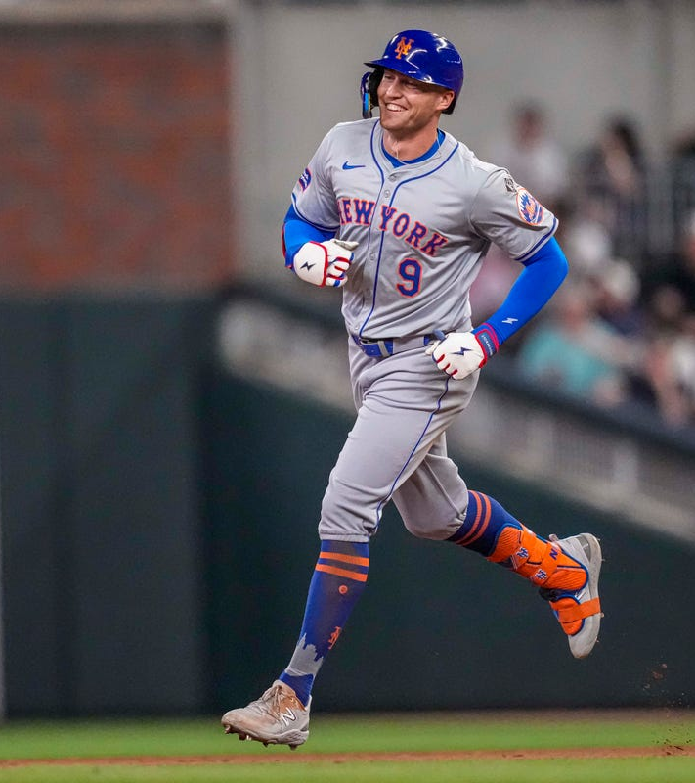
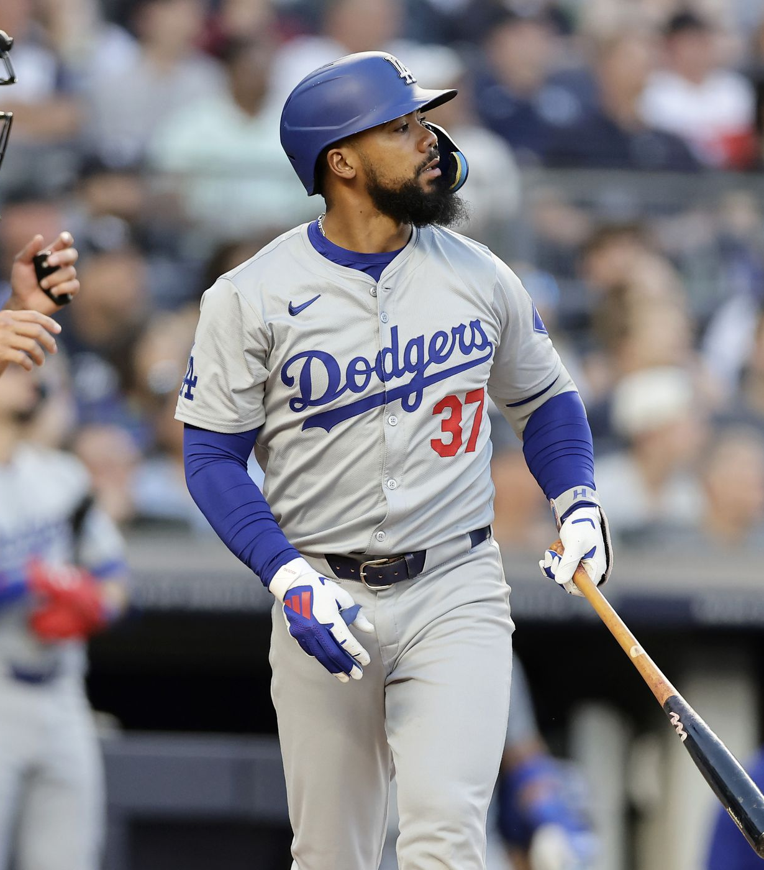
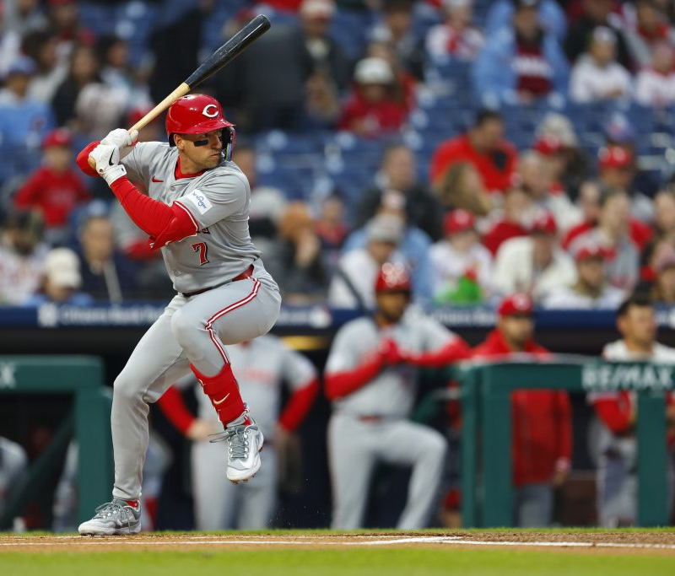
Player Examples

Slide 4
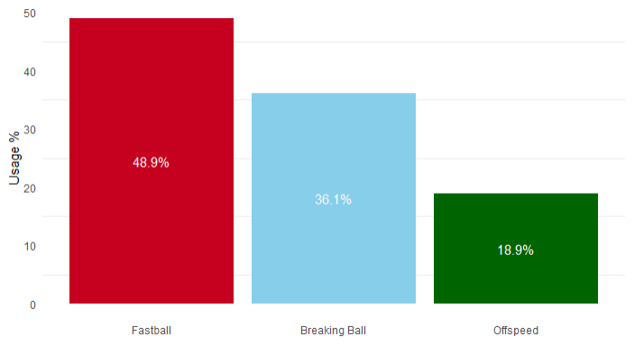
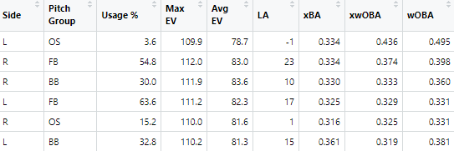
Brandon Nimmo (L), New York Mets
Pitch Mix Model:
Historical Context (Sorted by xwOBA):
Good against RHP
Can expect more LHP matchups and more BB

Slide 5
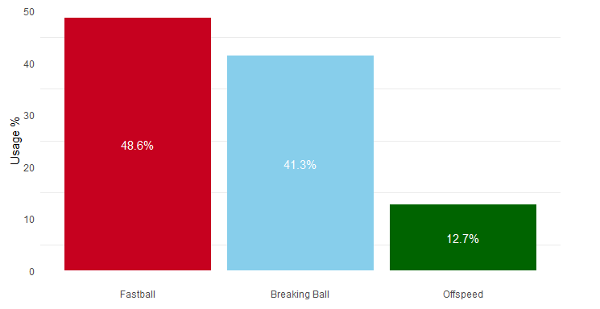
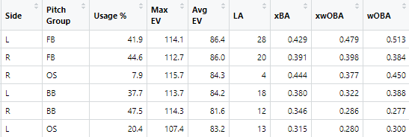
Teoscar Hernández (R), Los Angeles Dodgers
Pitch Mix Model:
Historical Context (Sorted by xwOBA):
Very Good FB Hitter
Will see more RHP BB and LHP OS pitches

Slide 6
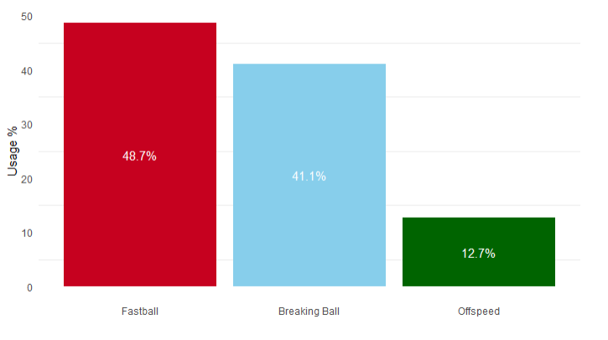
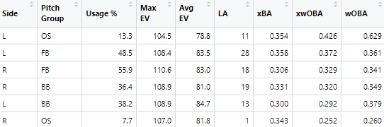
Spencer Steer (R), Cincinnati Reds
Pitch Mix Model:
Historical Context (Sorted by xwOBA):
Best against LHP
Can expect more RHP matchups and more BB

Slide 7
Thank you! Questions?

